Slide 1


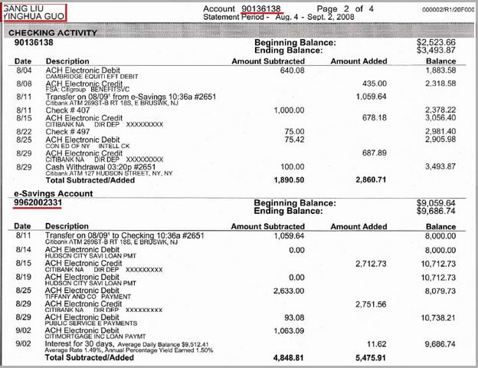
Words related to
Bank Account

Slide 2
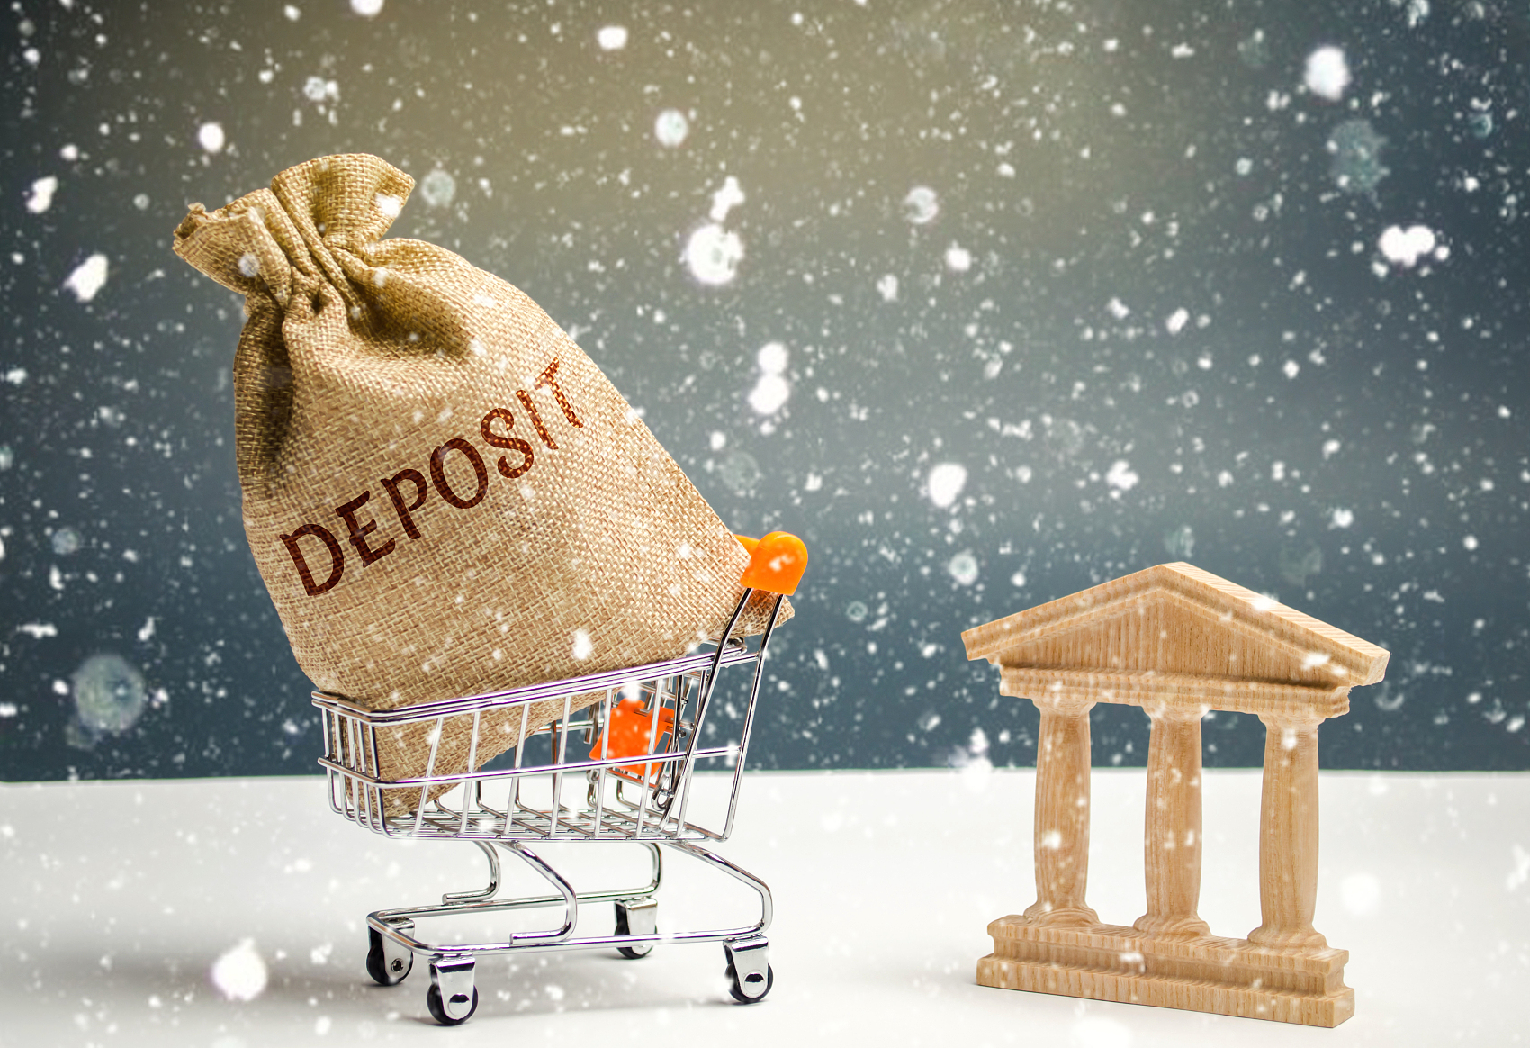
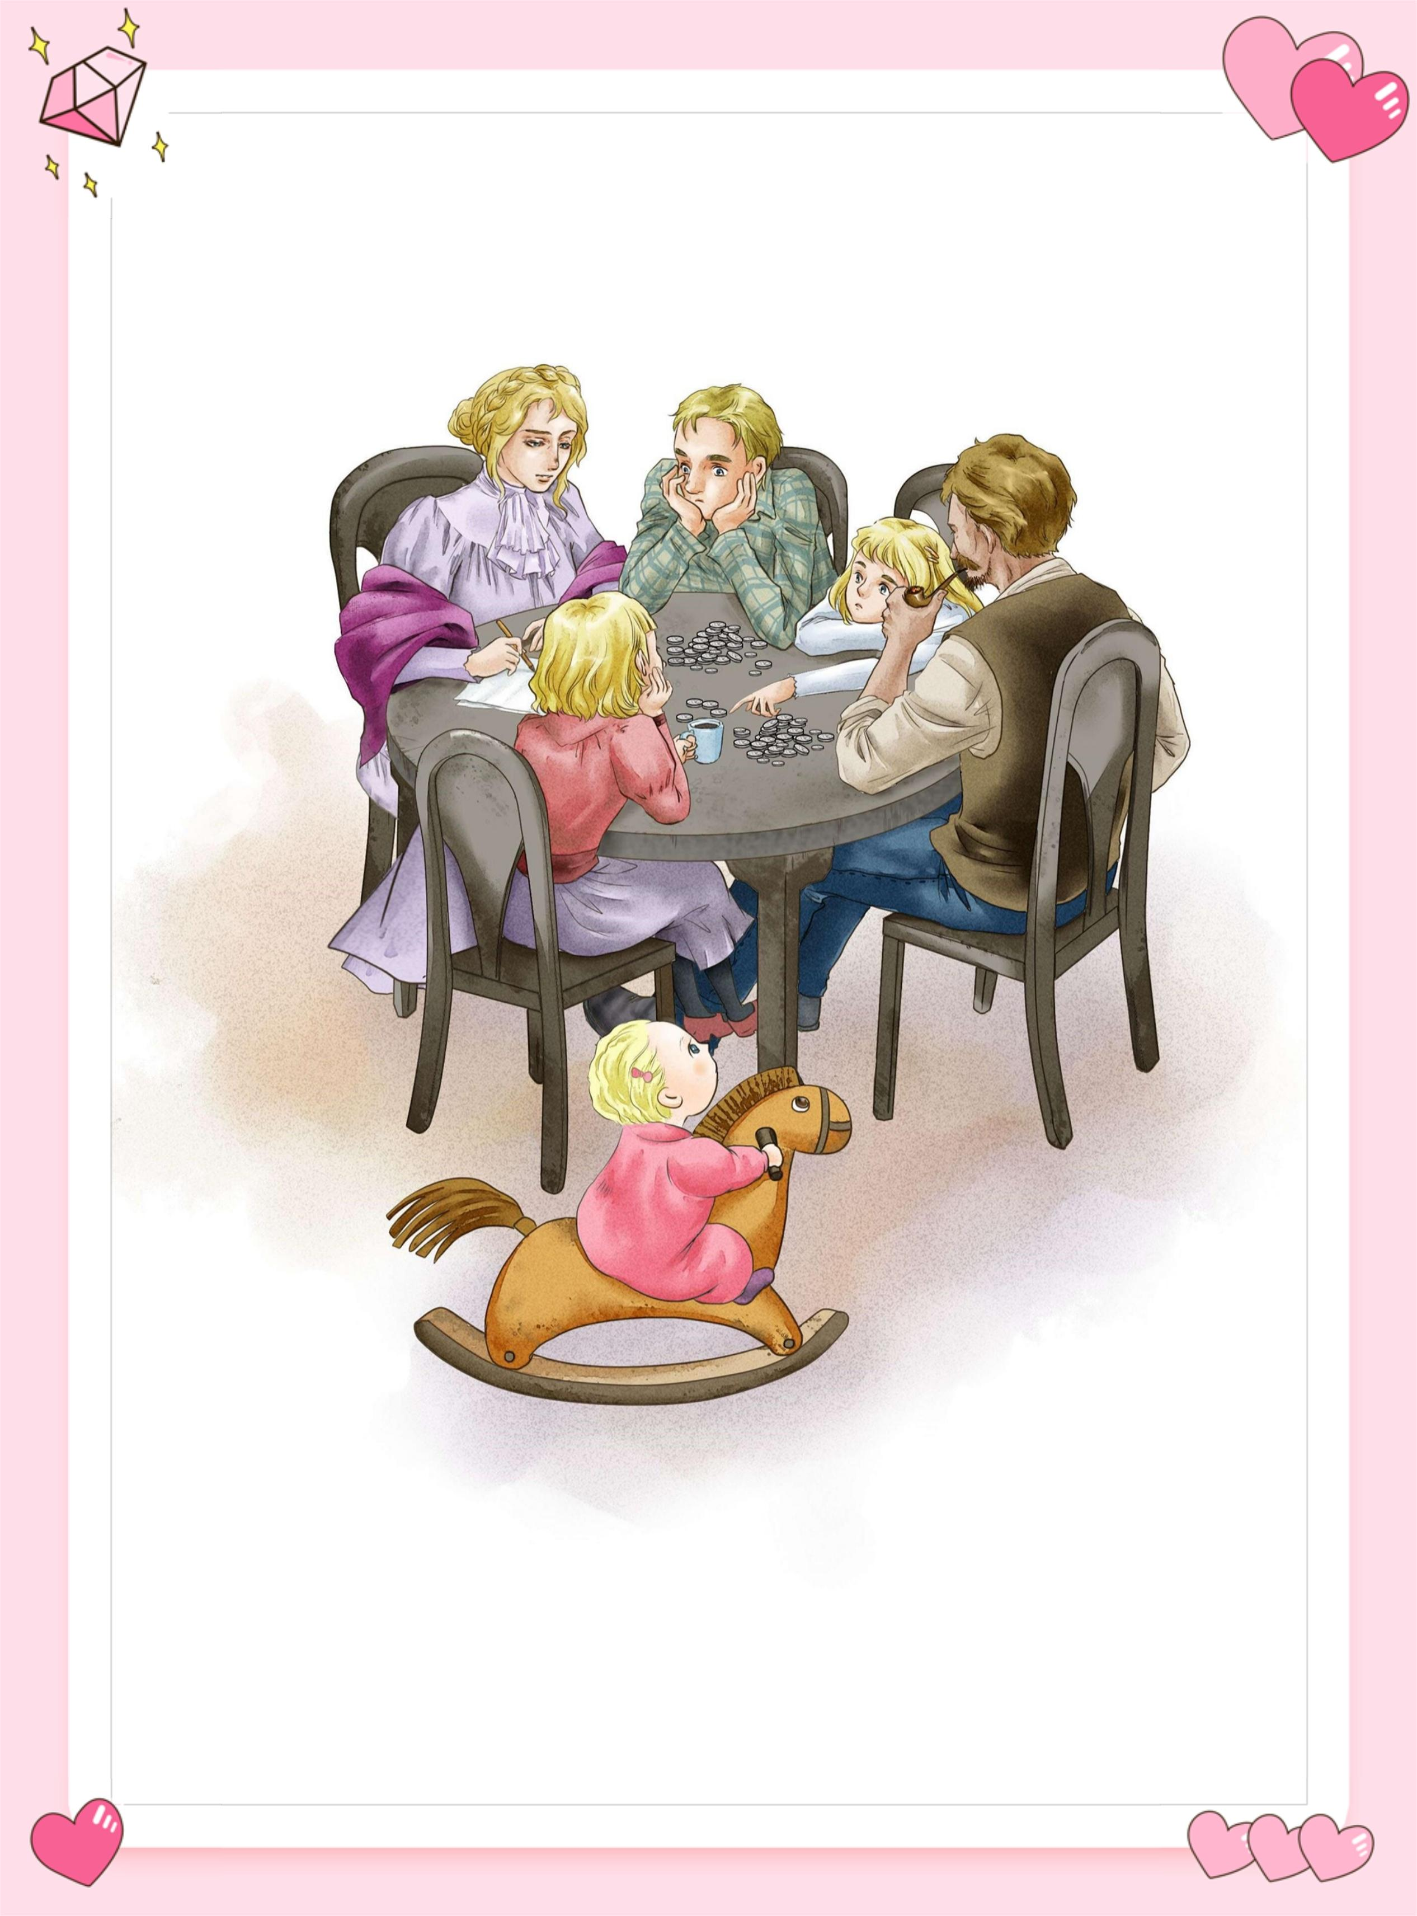
Unit 2 Extended Reading
Mama and Her Bank Account

Slide 3

Could you predict（预测） what happens in the story based on the title “Mama and Her Bank Account”?

Slide 4

T or F
Mama is a Billionaire.
Mama’s bank account helped us through the financial emergency.
Mama doesn’t own a bank account.
Please read and check your prediction.

Slide 5
Structure (Match the main idea with each part)
to Mama’s Bank Account
There wasn’t a real bank account and Mama just wanted us to feel secure.
Part1(1-5)
Part2(6-13)
Part3(14-15)
Part4(16-22)
I
ntroduction
Mama used the money wisely, which ensured we didn’t have to go to the Bank.
of Mama’s Bank Account
S
tories
Everyone in the family would do something to help Nels go on to high school, so we didn’t have to draw money out of Mama’s Bank Account.
of Mama’s Bank Account
Whatever happened, we still had the Bank Account to depend upon.
T
ruth

Slide 6
Plot (structure) of the story
20 years ago
20 years later
Scene 1 Para1-5
How many scenes can this story be divided into?
Scene 2 Para6-15
Scene 3 Para16-22
When Nels went on to high school
Last year
Every Saturday night
.

Slide 7
Plot (structure) of the story
Scene 1 Paras.1-5
Every Saturday night
That was 20 years ago (L35)
Scene 2 Paras.6-15
When Nels went on to high school
Scene 3 Paras.16-22
Last year
How is the article organized(组织)?
A. Time order B. Space order C. Logic order
.

Slide 8

Scene 1 Saturday Routine P1-5
What did Mama do every Saturday night?
How was the money distributed(分发)?

Slide 9
Scene 1 Saturday Routine P1-5
What did Mama do every Saturday night?
Mama would sit down by the kitchen table and count out the money.
How was the money distributed(分发)?

Slide 10
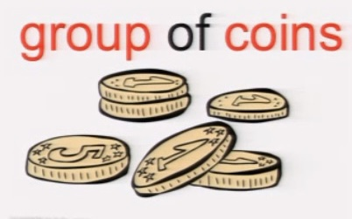
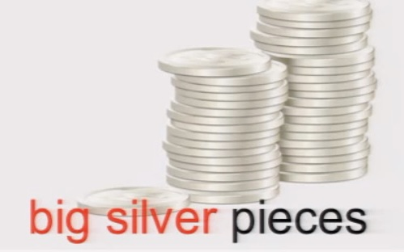
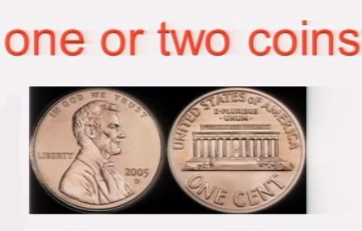
Scene 1 Saturday Routine P1-5
How was the money distributed (分发)?
poor
groceries
a note book
rent
maybe the rest of coins

Slide 11

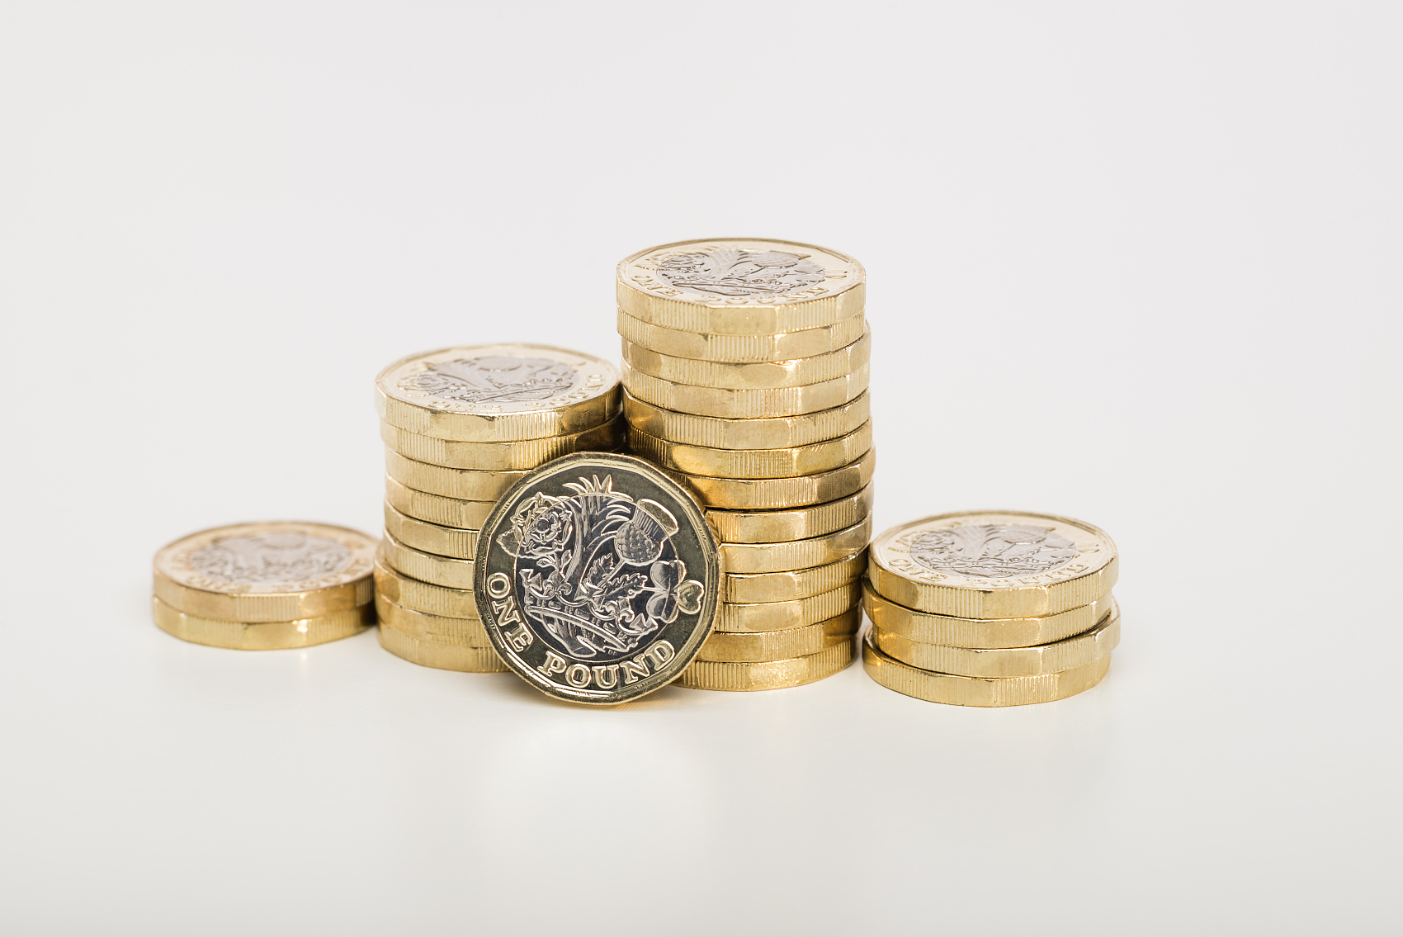









Scene 2
Emergency P6-15
Flip Game
How many kids were there in the family?
What caused a big financial problem in the family?
What was Little Bank used for?
How did they overcome the financial problem?
What is the secret of Mama’s bank account?

Slide 12

Scene 3 Truth P16-22
1. Does Mama’s Bank Account exist?
2. Why did Mama make up such a lie to her children? Can you find sentences in the short story to prove your answer?

Slide 13
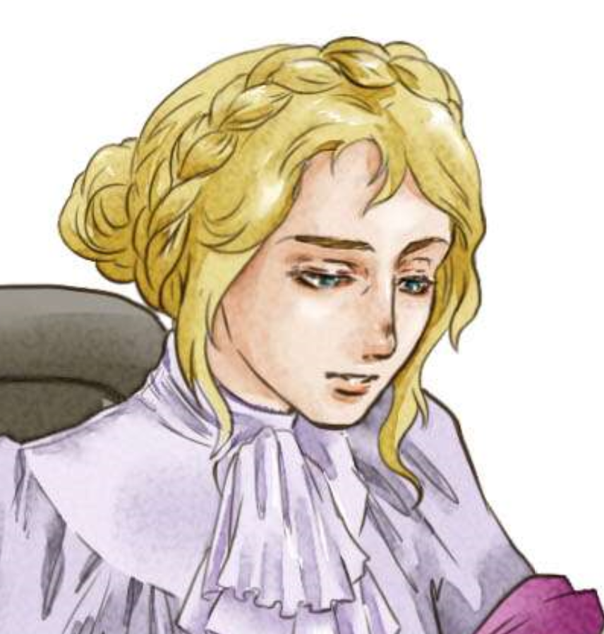
Scene 3 Truth P16-22
1. Does Mama’s Bank Account exist?
No. Mama told a lie.
2. Why did Mama make up such a lie to her children? Can you find sentences in the short story to prove your answer?

Slide 14
Scene 3 Truth P16-22
Because she wanted to provide a sense of security to her children and give them the courage to face up to difficulties.
1)We were all so proud of Mama’s Bank Account. It gave us such a warm, secure feeling.(Lines 9-10)
2)Whatever happened, we always knew we still had the Bank to depend upon.(Lines 32-34)
3)And when I didn’t— couldn’t—answer, Mama said seriously, “It is not good for little ones to be afraid—to not feel secure.” (Lines 45-46)

Slide 15
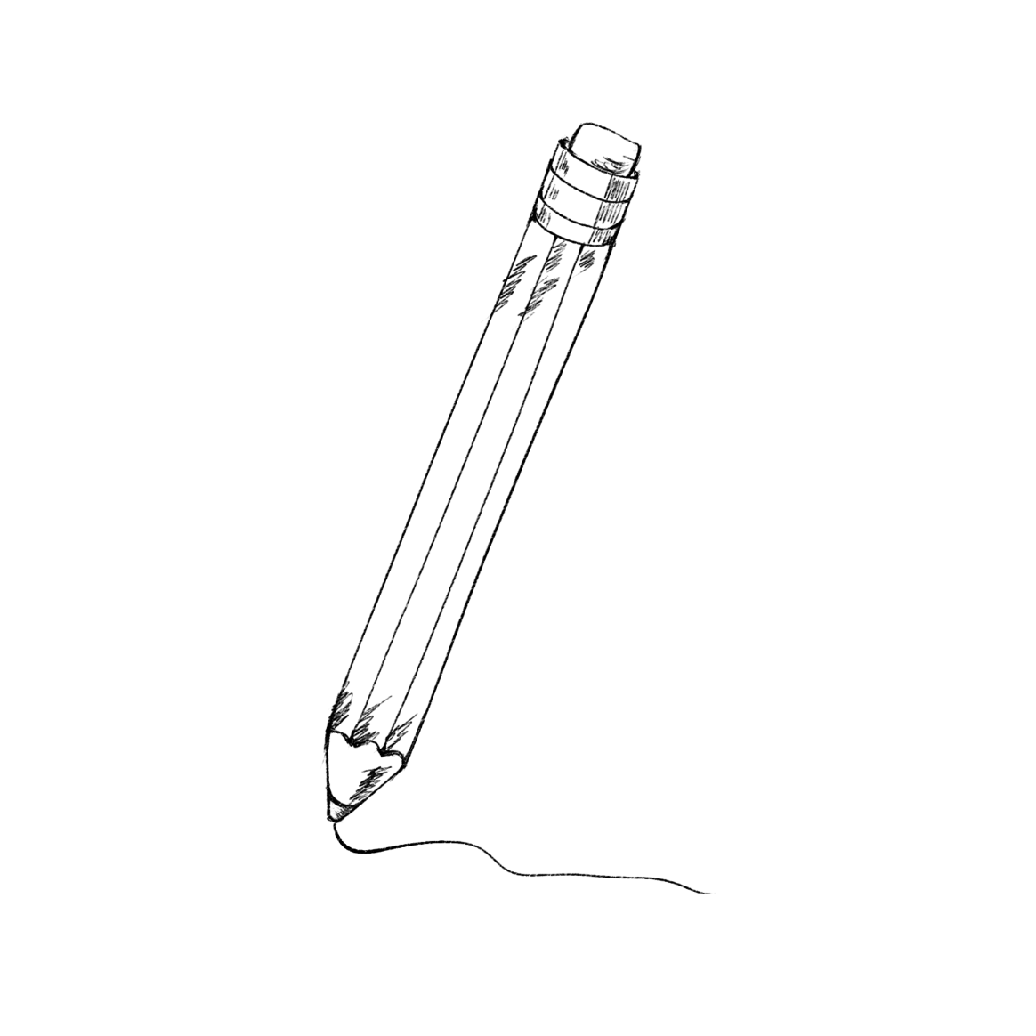
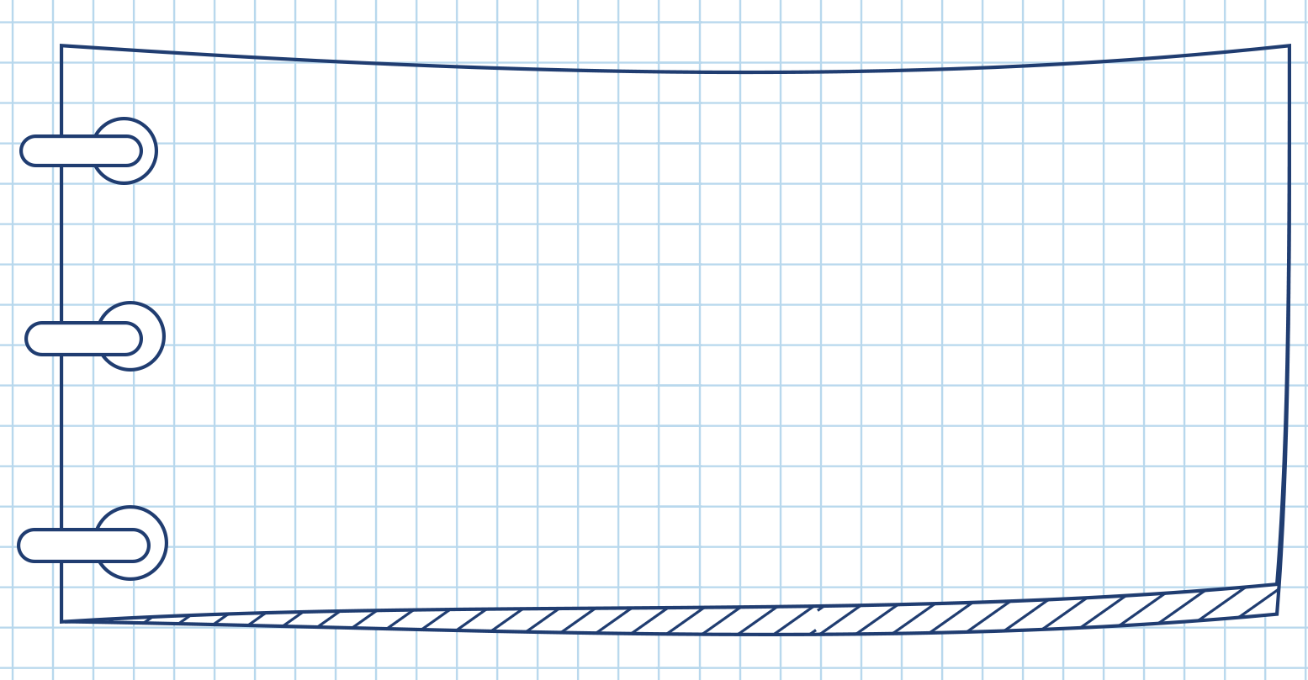

Four key elements of a short story
Who
where
when
what
why
how
Character
Setting
Plot
Theme

Slide 16
Read the story again and complete the table of part A on page 26
setting
character
plot
theme
setting
character
plot
theme

Slide 17
Analyze the basic elements
Setting
A family living in the US in the early 1900s
Characters
Mama, Papa, Nels, Katrin, Christine, Dagmar

Slide 18
Plot
poor
In Katrin’s childhood, though _______, her family worked hard and s_________each other so that they never needed to get money from Mama’s _____________. _____ years later , Kathrin found out that the bank account did not exist . Mama made up the bank account to make the children feel______.
upported
Bank Account
20
secure
Theme
A mother has deep love for her children and does whatever she can to protect them.

Slide 19

Appreciation

Slide 20
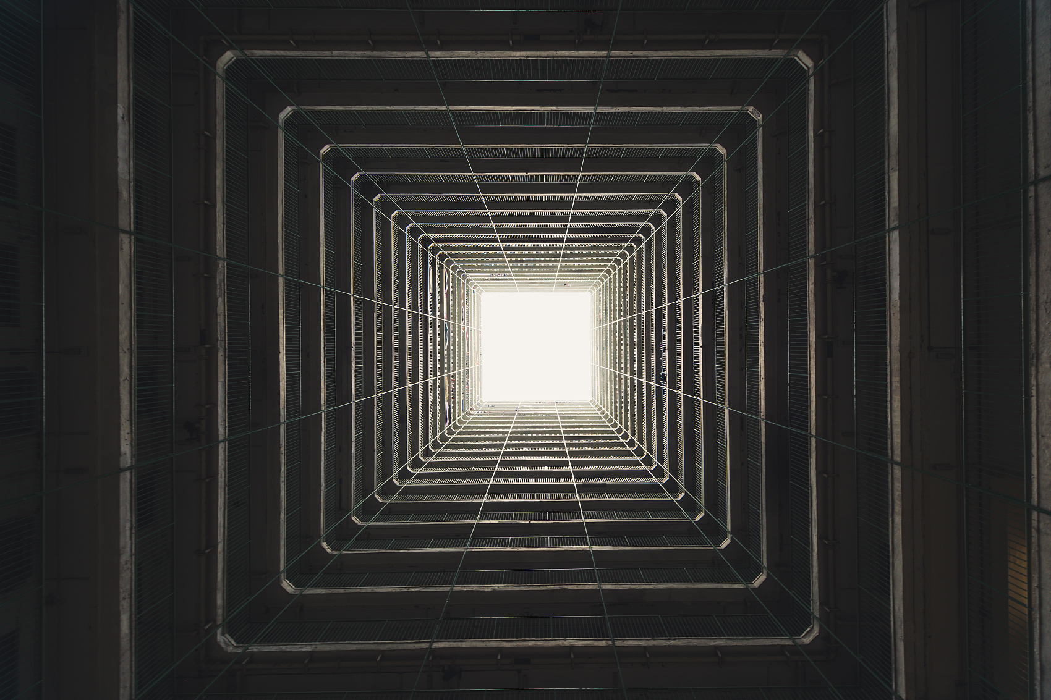
We would watch with anxious interest. ...
Eagerly we gather around the table. ...
“I will look after the Elvington children every Friday night,” I said.
The First Person

Slide 21

“For the rent.”Mama would count out the
big silver pieces.“For the groceries.”Another
group of coins.”
Short sentences
&
Dialogues

Slide 22

“That’s not enough,”Papa said. Then he
took his pipe out of his mouth and looked at it
for a long time.“I will give up smoking,”he said
suddenly. Mama reached across the table and
touched Papa’s arm
Description of Movement

Slide 23
A sense of kinship
Concise&Natural
Easy to understand
Vivid&Powerful
The First Person
Short sentences&Dialogues
Description of movement
Closer to characters

Slide 24
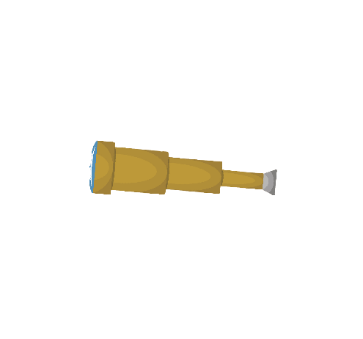
Character Analysis

Slide 25
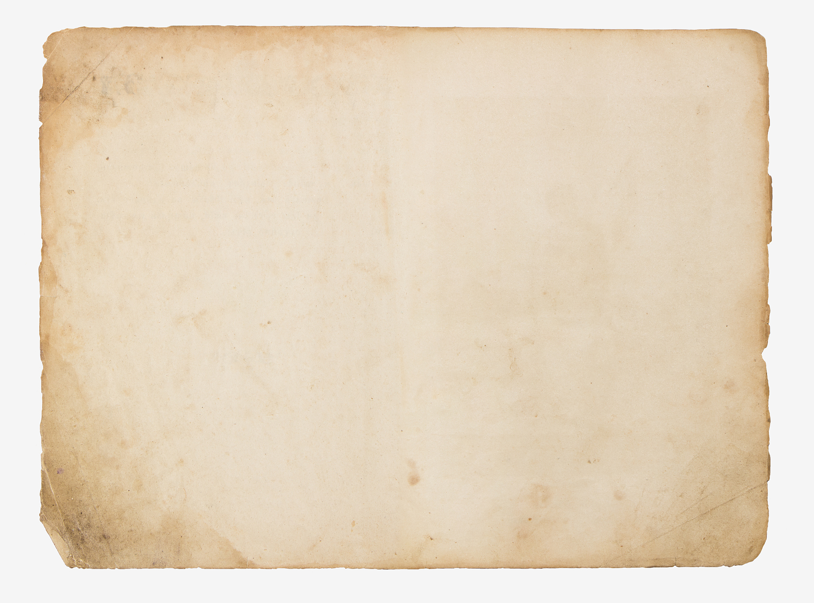
What are Mama’s personality traits?
Evidence: From Line .
Trait: Mama is a/an adj. person
Every Saturday night Mama would sit down by the kitchen table and count out the money Papa had brought home. "For the rent." Mama would count out the big silver pieces. "For the groceries." Another group of coins.
From Line 1-5: Mama would count out the money every saturday night, we can see/tell/know that Mama is a person
Well-organized

Slide 26
"I'll need a notebook." That would be my sister Christine, my brother Nels or me.
Considerate
Mama would put one or two coins to the side.
Thrifty
Mama would look up and smile,“Good. We do not have to go to the Bank."
Optimistic
Warm&
Dependable
We were all so proud of Mama's Bank Account. It gave us such a warm, secure feeling.

Slide 27
Wise&
Persistent
“We do not want to go to the Bank," she reminded.
Mama gave him a bright smile and wrote down a number.
Mama reached across the table and touched Papa's arm.
Gentle&
Encouraging
Mama said seriously, “It is not good for little ones to be afraid--to not feel secure."
Responsible
Devoted
Omnipotent-Ordinary
and Mama's hair was silver now.
“You will go with me, Katrin?"

Slide 28

Indirect Characterization
Writers most often use indirect characterization to show (not tell) things that reveal the personality of a character.
The Character’s speech
The Character’s thought
The effect that character has on others
The Character’s actions
The physical looks of the Character
“STEAL”

Slide 29

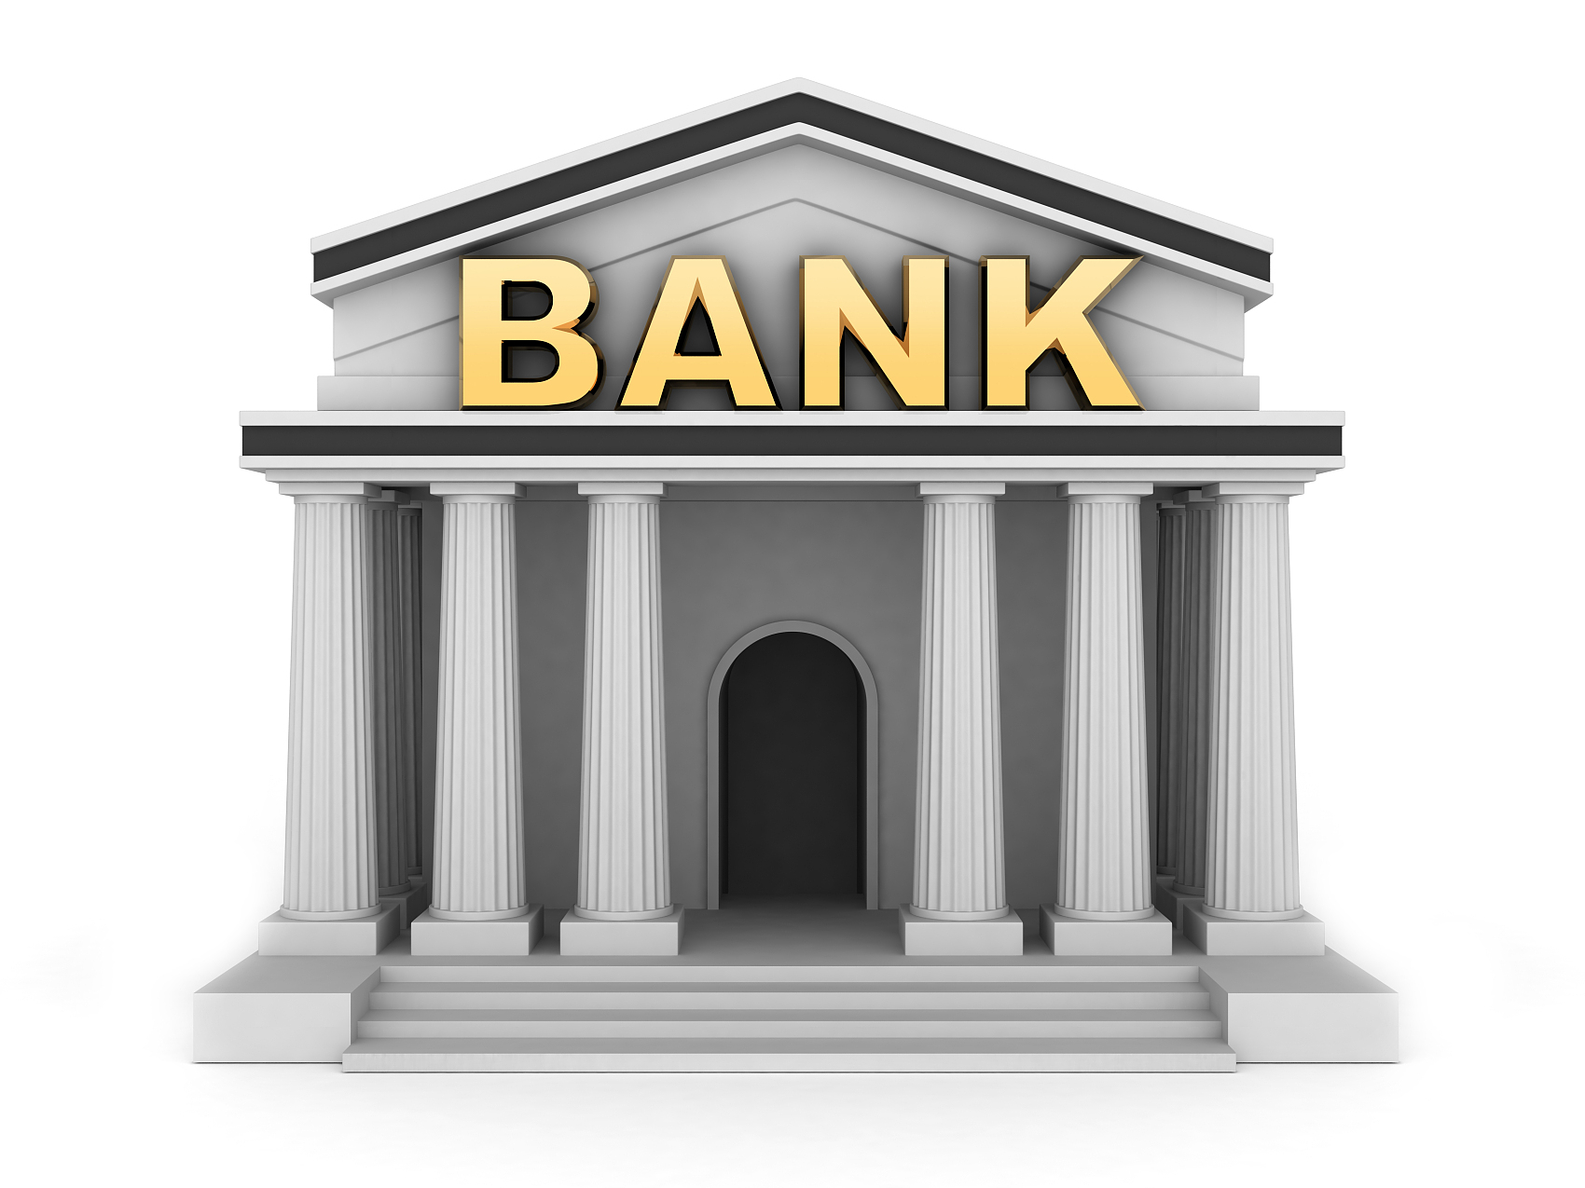
Mama and Her Bank Account
Deposit into
Withdraw from
love, hope, faith, wisdom,
courage
warmth, security, gratitude, optimism,
confidence
Mama’s love was, is and will always be there.

Slide 30

In our Continuation Writing, we should:
Sort out the key elements
Figure out the personality traits of main characters
Apply detailed descriptions to shape your character
Stick to the given sentence logically

Slide 31

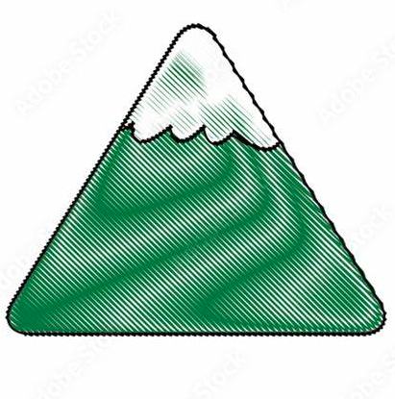
Read for the basic elements
Katrin found there was no bank account.
The plot mountain
Climax
Nels needed money urgently. The whole family worked together and solved the problem.
...
Development
Ending
Beginning
Mama counted out the money.

Slide 32
Post reading
What would happen after Katrin knew Mama's secret of the Bank Account?
Climax
Development
Ending?
Beginning

Slide 33

Continuation writing
I felt a great sense of appreciation welling up in my heart and surging through me.（我感到一股强烈的感动在我心里升腾、奔涌。）
________________________________________________________
1.动作描写：
eg.Mama reached across the table and touched Papa’s arm. Then she wrote down another figure. (Line23)
key words: raised my head, stare at(盯), hugged
2.语言描写：
Mama said seriously,“It is not good for little ones to be afraid -to not feel secure.” (Lines45-46)
key words: the happiest person, uttered(说)

Slide 34
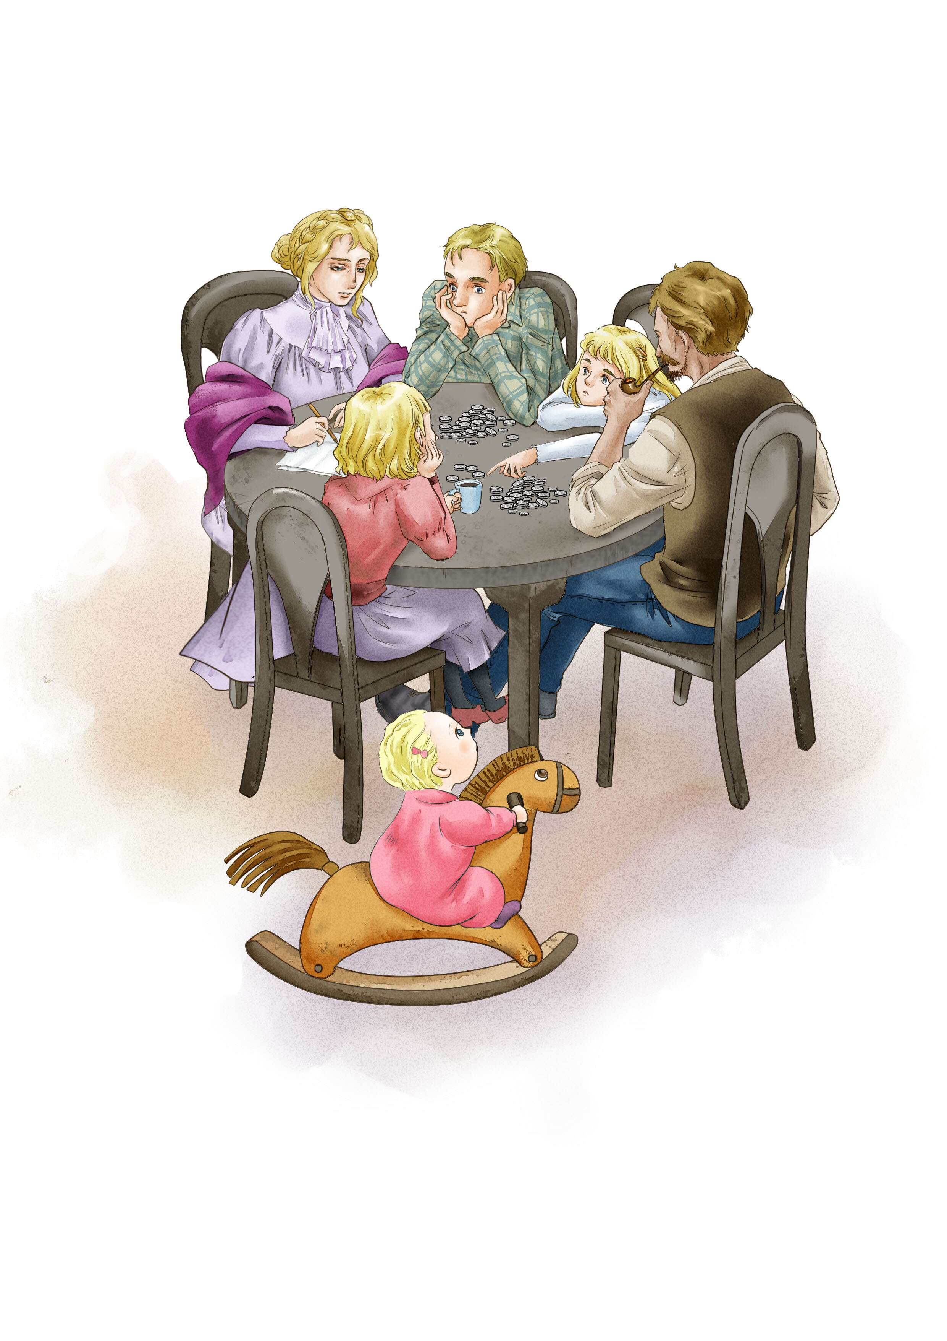
How many kids were there in the family?
Nels
Christine
Brother:(2)______
Sister:(1)_________
Mama
Papa
Katrin
I :(3)_______
Dagmar
Little sister:(4)________

Slide 35
What caused a big financial problem in the family?
Nels wanted to go on to high school,
but the family didn’t have enough money.
L11, L17

Slide 36
What was Little Bank used for?
It was used for sudden emergencies. L14

Slide 37
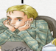
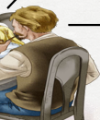
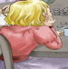
How did they overcome the financial problem?
The whole family worked together. L19 – L26
Nels →
would work in a grocery after school.
Papa →
would give up smoking.
would look after the Elvington children every Friday night with her younger sister.
I →

Slide 38
What is the secret of Mama’s bank account?
There is no bank account. L43

